Slide 1
USDA Strengthening Organic Enforcement Rule (SOE)
The ReposiTrak Traceability Network®
Understanding the new rule’s requirements for traceability and documentation
January 29, 2024

Slide 2
A few details before we get started…
You can submit questions in the question pane
All registrants will receive the webinar recording
You will receive a brief survey for feedback and request to contact

Slide 4
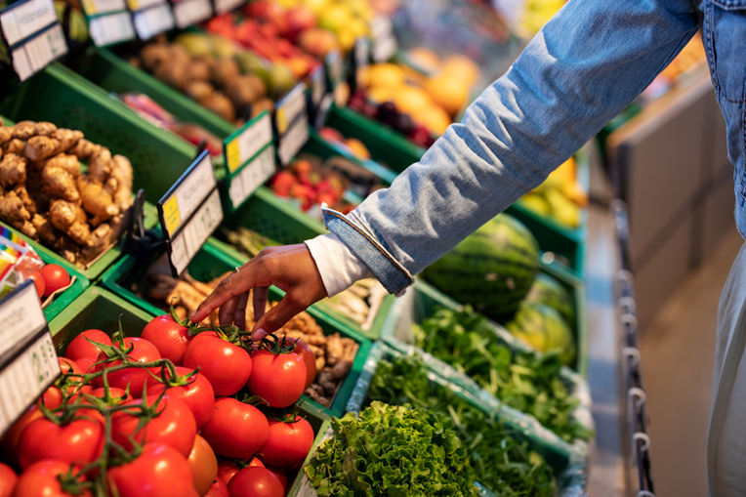
Purpose of the SOE Rule
The Strengthening Organic Enforcement (SOE) rule aims to enhance oversight and enforcement of the production, handling, and sale of organic products and prevent economic fraud.
Focuses on improving organic control systems, farm-to-market traceability, and enforcing organic regulations more robustly.
Most significant update to organic regulations since the original Act in 1990.

Slide 5
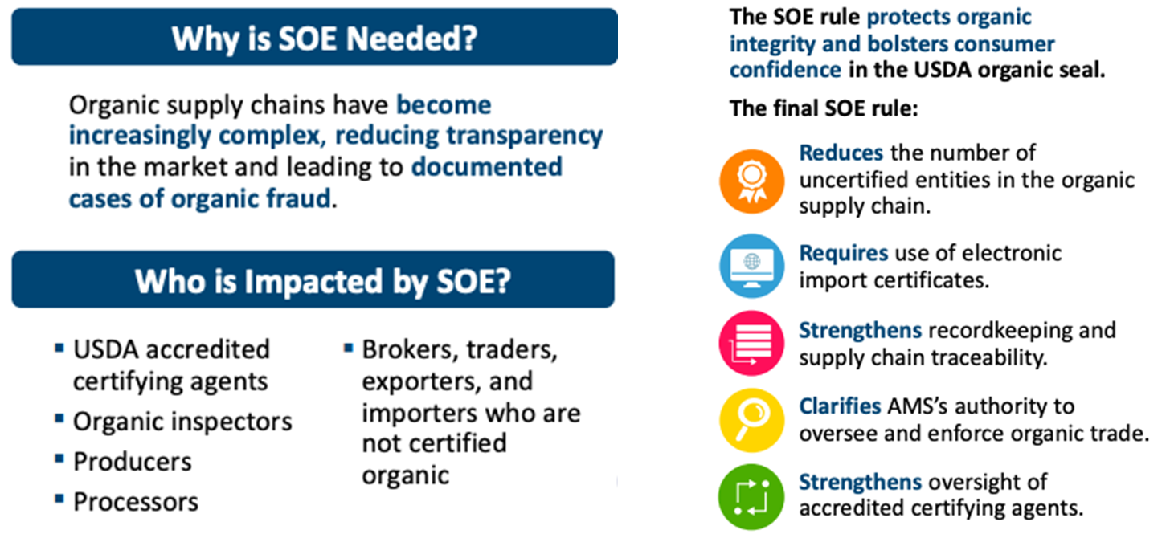
“Why” and “Who”

Slide 6
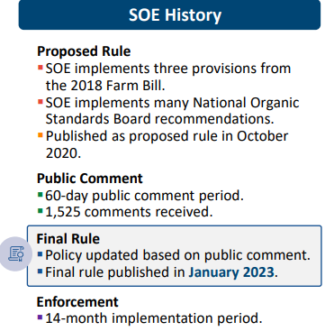
“When” and “What”
The rule covers all organic products, requiring more businesses in the organic supply chain, like brokers and traders, to be certified.
It mandates NOP Import Certificates for all organic imports and necessitates organic identification on nonretail containers.
Deadline for compliance is less than 2 months away!

Slide 7
Exemptions
Small Producers: Operations with organic sales totaling $5,000 or less annually.
Retail Establishments: Retailers that do not process organic products, including most grocery stores.
Retail Processors at Point of Final Sale: Retail establishments that process organic products at the point of final sale (like restaurants and stores that prepare food on-site).
Handlers of Products with Less than 70% Organic Ingredients: Handling operations that only handle agricultural products containing less than 70% organic ingredients or that only identify organic ingredients on the information panel.
Storage Operations with Sealed Packaging: Operations that only receive, store, and ship organic products enclosed in sealed tamper-evident packages or containers.
Wholesalers with Sealed Retail-Packaged Products: Wholesalers that only sell organic products labeled for retail sale and enclosed in sealed tamper-evident packages or containers.
Customs Brokers: Customs brokers that only conduct customs business.
Logistics Brokers and Transporters: Operations that only arrange for the shipping, storing, transport, or movement of organic agricultural products.

Slide 8
Traceability Requirements
Supply Chain Traceability Audits:
Certifiers must conduct risk-based supply chain traceability audits to verify the compliance of agricultural products with organic regulations.
These audits aim to trace products across multiple supply chain links, ensuring traceability between operations.
Onsite Inspection Requirements:
Onsite inspections must verify that organic products and ingredients are traceable from the time of purchase or acquisition through production to sale or transport, ensuring compliance back to the last certified operation.
Inspections must assess the internal control system's compliance, including a review of internal inspections and conducting witness audits of internal control system inspectors.
Certifiers are required to perform mass-balance or “in-out” audits during full annual onsite inspections to confirm that inputs match outputs, which helps in detecting and discouraging fraud.
Recordkeeping for Traceability:
Operations must fully disclose all activities and transactions in sufficient detail to be readily understood and audited.
Records must span from the time of purchase or acquisition through production to sale or transport and be traceable back to the last certified operation.

Slide 9
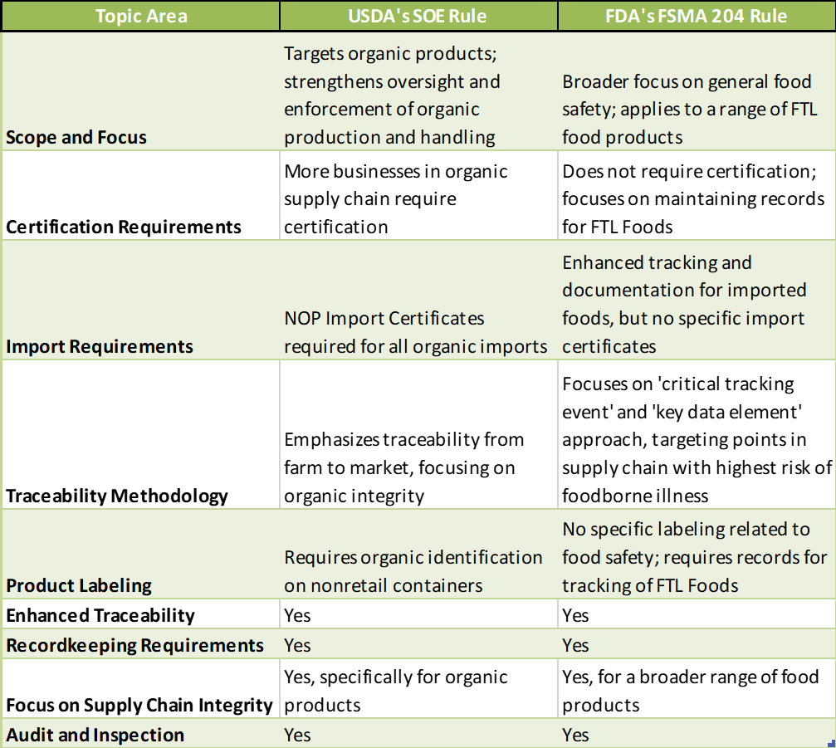
USDA SOE vs FDA FSMA 204

Slide 10
ReposiTrak’s findings: The amount of time and effort required to develop and implement a traceability program is far greater than most people think

Slide 11
Steps to take NOW
Certified Organic Product Suppliers
Evaluate your non-retail packaging for traceability compliance.
Integrate the work into a broader traceability system….some customers are tracing all food products.
Make sure your management team understands the risk of customer fragmentation and look for technical solutions that require little to no new work or cost for you or your customers.
Wholesalers/Distributors/Self-Distributed Retailers
Identify the products and suppliers you need to track/trace…this is not easy!
Identify the DC/warehouse systems and processes that need to change.
Identify and establish the human and technology infrastructure required to support traceability.

Slide 12
Currently…
2,000+
25+
5,000+
Suppliers in Queue
DCs/Warehouses
Retail Stores
The ReposiTrak Traceability Network®
Others are talking about FSMA 204 food traceability,
but ReposiTrak is doing it.
Notes:
12/15 updated

Slide 13
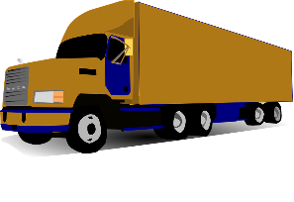
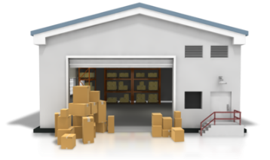
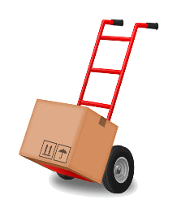
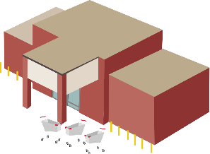
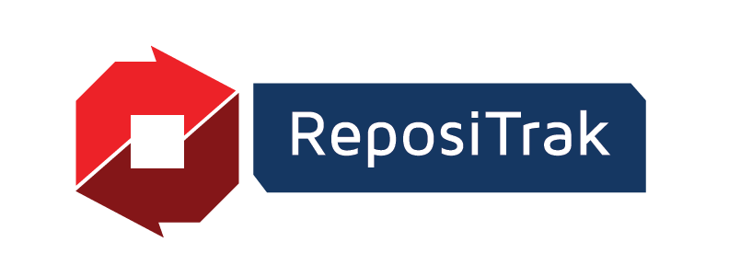
The same traceability technology used today that tracks millions of items into stores, annually!
Creation, Growing or Processing
of Product
Shipping
to DC
Receiving at DC
Shipping to Store
Receiving at Store
ReposiTrak Gathers Electronic Documents
We gather normally incompatible information into our system via electronic documents currently being used today when a product moves from shipper to receiver (ASNs, BOLs, etc.)
ReposiTrak Extracts and Maintains all Data Elements
We extract all data elements from the documents and maintain them with their shipper and receiver relationships
We require no special data formats or communication type, we can translate from ANY format and have been for over 20 years
Some of the KDEs are NOT found today on labels or in standard barcodes
ReposiTrak Creates the NEW Required Record
We combine required KDEs from multiple documents sourced from both the shipper and the receiver and create the new record required by FDA

Slide 14
Thank you!
Derek Hannum
Chief Customer Officer
Dhannum@repositrak.com
435-645-2230

